Slide 1
assignment
24-03-2025
Presented by S.Vinish

Slide 2
What are the ports & port numbers available in SAP to connect?
Message Server (3600-3699)
ICM HTTPs Port (443)
Internal SAP instance communication; load balancing. Example: 36<instance number>.
Web-based access to SAP systems.
SAP GUI (RFC Protocol) – 32 <Instance Number>
Gateway (3300-3399)
Communication between SAP and external systems using RFC. Example: 33<instance number>.
Used for GUI connections.
SAP Cloud Connector HTTP (8443)
Dispatcher (3200-3299)
Handles user connections; distributes workload. Example: 32<instance number>.
Secure connection between SAP Cloud and On-Premise.
Custom Ports
Specific integrations or custom applications.
ICM (Internet Communication Manager) HTTP Port (8000)
Web-based access to SAP systems.

Slide 3
Differences between AS ABAP & AS JAVA from its architecture
AS ABAP(Advanced Business Application Programming) is used to run SAP applications based on ABAP programming languages ​​such as SAP ERP and SAP S/4HANA.
Architecture Components:
Dispatcher, Work Processes: Executes tasks (dialog, update, background, enqueue, spool), Enqueue Server, SAP GUI / Web Dynpro ABAP, Database Layer.
AS Java is a Java EE-compliant runtime environment for running SAP applications written in Java, such as SAP Portal, SAP PI, and custom Java applications.
Architecture Components:
Internet Communication Manager (ICM), Server Nodes, Software Deployment Manager (SDM), Message Server, Database Layer.

Slide 4
Differences between AS ABAP & AS JAVA from its architecture

Slide 5
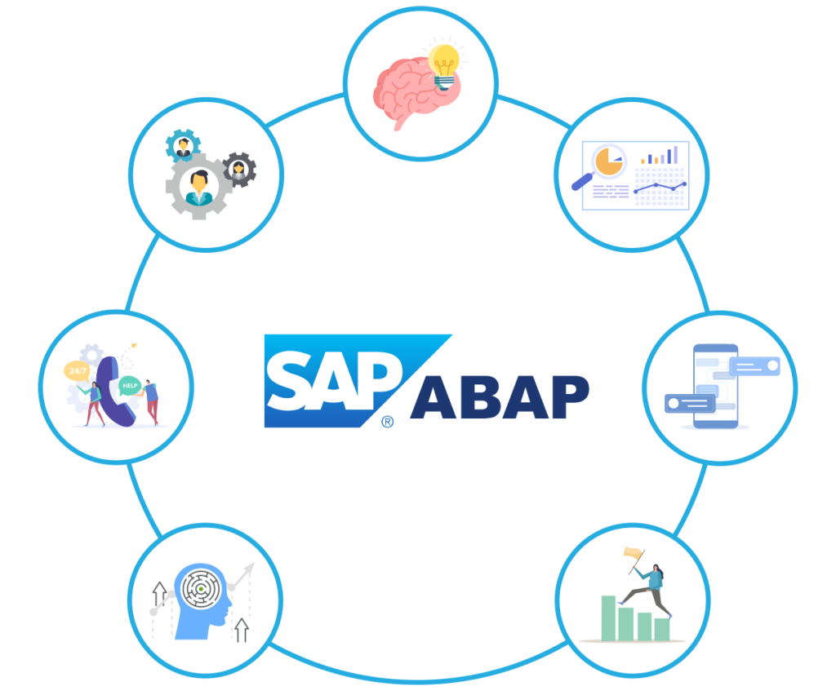
What is AS ABAP?
AS ABAP(Advanced Business Application Programming) is used to run SAP applications based on ABAP programming languages ​​such as SAP ERP and SAP S/4HANA.
Architecture Components:
Dispatcher, Work Processes: Executes tasks (dialog, update, background, enqueue, spool), Enqueue Server, SAP GUI / Web Dynpro ABAP, Database Layer.

Slide 6
What is AS Java?
AS Java is a Java EE-compliant runtime environment for running SAP applications written in Java, such as SAP Portal, SAP PI, and custom Java applications.
Architecture Components:
Internet Communication Manager (ICM), Server Nodes, Software Deployment Manager (SDM), Message Server, Database Layer.

Slide 7
COMPARISON BETWEEN AS ABAP & AS JAVA
Feature | AS ABAP | AS Java
Programming Language | ABAP | Java (Java EE)
Use Case | Business applications (e.g., ERP, S/4HANA) | Web applications, integrations (e.g., SAP PI, SAP Portal)
UI Technologies | SAP GUI, Web Dynpro ABAP | SAP UI5, Web Dynpro Java, JSP
Execution Model | Work process-based | Java Virtual Machine (JVM) based
Locking Mechanism | Enqueue Server | Java Synchronization
Custom Development | ABAP Reports, Function Modules | Java Servlets, EJBs, JSP

Slide 8
Can we have more than one enqueue server in an SAP System?
Enqueue server manages locks on data to ensure only one user or process can modify it at a time, preventing data conflicts.
It is also known as Lock Server.
No, an SAP system cannot have more than one enqueue server.
SAP provides Enqueue Replication Server (ERS) to improve system resilience in HA(High Availability) setups.
It is responsible for managing locks on database records to prevent data inconsistencies
Standard SAP System: ❌ No, only one Enqueue Server per system.
High Availability Setup: ✅ Yes, but only one active Enqueue Server at a time, with an Enqueue Replication Server as a backup.

Slide 9
Is it possible to introduce more that one enqueue server in a central instance?
No, an SAP system cannot have more than one enqueue server in a central instances.
The Enqueue Server is a singleton process.
Why Can’t We Have Multiple Enqueue Servers?
Lock Management Consistency
Architecture Limitation
Solution for High Availability (HA)
For HA, use Enqueue Replication Server (ERS) with ENSA2 architecture.
ERS2 provides automatic failover, making multiple Enqueue Servers unnecessary.

Slide 10
Main functions of enqueue server, except of locking the table entries.
These are the other main function of the enqueue server:
Lock Table Management
Communication with Work Processes
Integration with Message Server
Handling Update Processes
Supporting High Availability (HA) via Enqueue Replication
Managing Lock Failures & Deadlocks
Performance Optimization

Slide 11
A user in SAP systems, who is in ABAP, will the same user be there in AS Java, or should I create a new user for systems separately?
By default, AS ABAP and AS Java have separate user management.
To avoid duplicate user creation, use UME with ABAP as the data source or configure LDAP.
SSO solutions help enable a seamless login experience across both environments.
How to Enable Single Sign-On (SSO) Between AS ABAP & AS Java?
SAP NetWeaver SSO: Uses SAML 2.0, Kerberos, or X.509 certificates to enable single authentication.
SAP Logon Tickets: If both AS ABAP & AS Java use the same user repository, SAP Logon Tickets allow seamless access without re-entering credentials.

Slide 12
Different types of user administration available in windows & Linux along with administration tools.
Aspect | Windows | Linux
User Authentication | Local, Domain (Active Directory) | Local, LDAP, PAM
User Management | GUI-based (Control Panel, ADUC) | CLI-based (useradd, passwd, sudo)
Permissions | NTFS ACLs & Group Policies | File permissions (chmod, chown, chgrp)
Default Admin Account | Administrator | Root (UID 0)
User Groups | Local Groups, Domain Groups | Primary & Secondary Groups
Remote User Management | Active Directory, PowerShell | SSH, LDAP

Slide 13
What is firmware? What are the operations/steps that will perform, while machine/laptop power on/boots up?
What is Firmware?
Firmware is a type of software that is embedded into a hardware device to control its basic functions. It acts as a bridge between the hardware and higher-level software, providing the necessary instructions for the device to operate.
Operations that happens while system Powering UP:
Step | Process | Description
1 | Power On | PSU supplies power to components.
2 | POST | BIOS/UEFI checks hardware (RAM, CPU, HDD, etc.).
3 | Bootloader | Loads OS kernel from disk.
4 | Kernel Initialization | Initializes drivers, file system, and processes.
5 | Login & Startup | User login and startup programs execute.

Slide 14
What are the components & its functions of a computer.
Component |  |  | Function
CPU (Processor) |  |  | Executes instructions and processes data.
RAM (Memory) |  |  | Temporarily stores active programs and data.
Storage (HDD/SSD) |  |  | Stores data and applications permanently.
Motherboard |  |  | Connects and allows communication between components.
Power Supply (PSU) |  |  | Provides power to all components.
GPU (Graphics Card) |  |  | Renders images, videos, and graphics.
Cooling System |  |  | Prevents overheating of components.
Input Devices |  |  | Allow users to provide input (Keyboard, Mouse).
Output Devices |  |  | Display and present results (Monitor, Speakers).
Networking Components |  |  | Enable internet and network connectivity.
Operating System (OS) |  |  | Manages hardware and software resources.

